Slide 1

Spelling Bee
Austin Wong

Slide 2
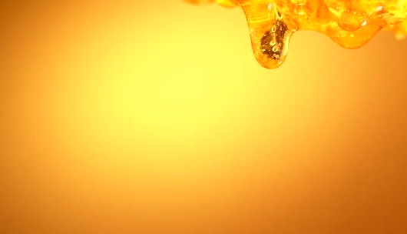
Project Description
Practice spelling by taking quizzes
Review previous quizzes
Track progress via quiz history

Slide 3
Project Description
Take Quiz
Generate 5 words with:
Pronunciation
Definition
Example Usage
Enter guesses
Calculate score
Save and display results

Slide 4
Project Description
Review Quiz
Quiz date
Score
Side-by-side comparison of words and guesses

Slide 5
Project Description
Track Progress
View all quizzes
Quiz date
Score
Review any quiz
Delete any quiz

Slide 6










Technologies Used
Notes:
Technologies Used:
Spring, Java, MySQL
Netbeans, Chrome, Github
Postman, Firefox, Git
APIs used not pictured: Merriam-Webster API (https://dictionaryapi.com) and random word API (https://random-word-api.herokuapp.com/home)
Languages used not pictured: HTML, CSS, Javascript, JQuery

Slide 7
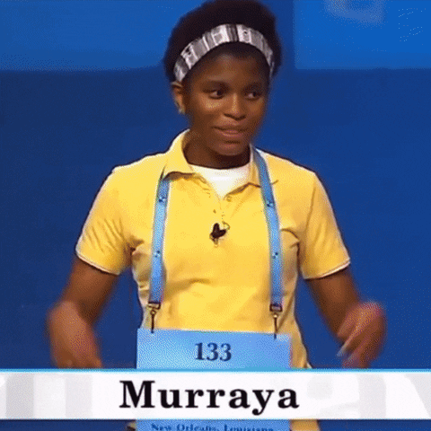
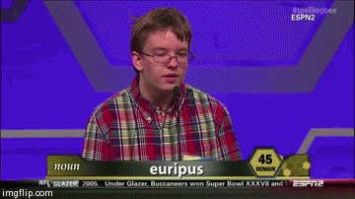
Demo

